Slide 1
PSCS337- FREENLANCING PLATFORM
PIP4004: University Project
Review-0 Presentation
Batch Number:IST-02
Roll Number | Student Name
20211IST0002 | M K SUGUNASHREE
20211IST0003 | HUZAIFA SHARIFF
20211IST0020 | SHAMITHA R
20211IST0026 | SUSHMITHA V M
Under the Supervision of,
Ms. MONISHA GUPTA
Professor
School of Computer Science and Engineering
Presidency University
Name of the Program: Bachelor Of Technology
Name of the HoD: Dr Pallavi R
Name of the Program Project Coordinator: Ms. Monisha Gupta
Name of the School Project Coordinators: Dr. Sampath A K / Dr. Abdul Khadar A / Mr. Md Ziaur Rahman

Slide 2
Content
Problem Statement
Github Link
Analysis of Problem Statement
Timeline of the Project
References

Slide 3
Problem Statement Number:
Organization: Government Of Punjab
Category (Hardware / Software / Both) : Software
Problem Description : 1.Freelancing Opportunities for India There is a significant gap in connecting freelancers and gig workers with short-term and project-based job opportunities.
An platform like upwork is needed to seamlessly connect freelancers with employers and provide tools for managing freelance projects.
Requirements: 1. Freelance Job Marketplace:
• Develop a marketplace where freelancers can find short-term jobs, gig work, and project-based opportunities.
• Allow employers to post projects, specify requirements, and invite freelancers to apply.

Slide 4
2. Freelancer Profile and Portfolio Management:
• Enable freelancers to create detailed profiles showcasing their skills, experiences, and portfolio of past work.
• Integrate a rating and review system for feedback on completed projects.
3. Extensive Search & Analytics:
• Enable Employers/Freelancers to do extensive search in the available data / generated data.
• Generation of AI enabled insights into the Data and providing newer ways of information availability for job seekers / employers to engage.
• AI based Recommendation Systems for seeking opportunities

Slide 5
4.Escrow Account Creation:
Create provisions for an escrow account that can be used to hold the money until the job is fully delivered.
Integrate secure payment gateways to facilitate smooth financial transactions between employers and freelancers.
Expected Outcome: The platform will connect freelancers with a wide range of job opportunities and provide them with tools to manage projects efficiently, leading to better job satisfaction and increased income opportunities.

Slide 6
NOTE : This is an innovation opportunity and students are encouraged to think out of the box to develop solutions which can be presented in newer ways + which can address the needs in out of the box ways for a certain industry OR makes the platform generic. Above description serves as a guide to specify essential needs that can be satisfied for the developed solution and is not limited only to the scope described.
Difficulty Level: Complicated

Slide 7
Github Link
The Github Link provided should have public access permission
Github Link
https://github.com/Sushmitha2712/Freelance-Platform

Slide 8
Analysis of Problem Statement
Technology Stack Components: Software - Web App development
Frontend: HTML/CSS/JavaScript/React .
Backend : Flask, Node.js.
Database: MySQL, MongoDB.
Hosting & Cloud: AWS ,Google Cloud, Azure.
Security: SSL/TLS encryption.

Slide 9
Analysis of Problem Statement (contd...)
Software Requirements:
Frontend: React, Angular, or Vue.js for a responsive UI.
Backend: Node.js, Django, or Laravel for server-side logic.
Database: MySQL, PostgreSQL, or MongoDB for storing user and project data.
Authentication: OAuth, JWT, or Firebase Authentication for secure login.
Payment Gateway: PayPal, Stripe, or Razorpay for transactions.

Slide 10
Analysis of Problem Statement (contd...)
Cloud Storage: AWS S3, Google Cloud, or Firebase for file management.
Real-time Chat: WebSockets or Firebase for communication.
Project Management: Task tracking and bidding system.
Security: SSL encryption, data validation, and user role management.
Hosting: AWS, DigitalOcean, or Firebase for deployment.

Slide 11
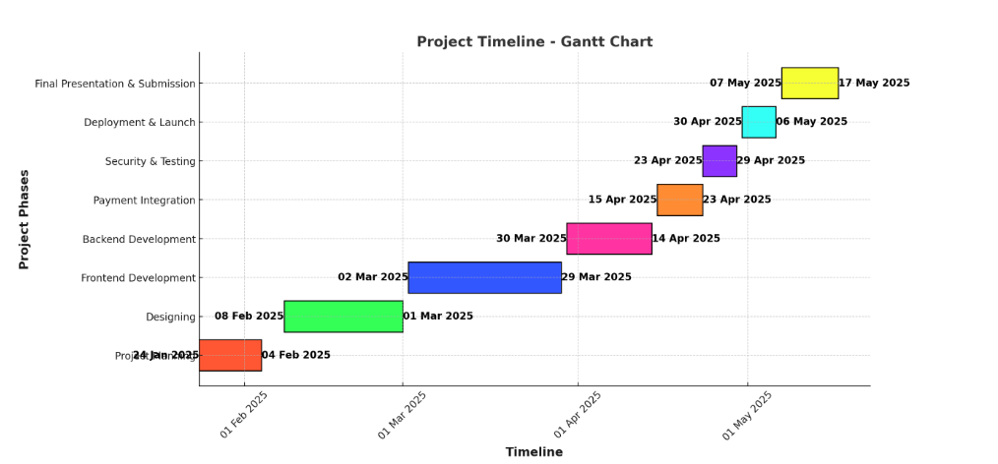
Timeline of the Project (Gantt Chart)

Slide 12
References (IEEE Paper format)
Please put the link API ciatation style

Slide 13


